Slide 1

CFL condition
Related to information propagation.
Numerical solution should not move faster than analytic.
This means:
For some methods CFL = 1 means a perfect propagation speed.
Easy proof that Lax-Wendroff and Upwind converge to the exact solution when CFL =1.

Slide 2
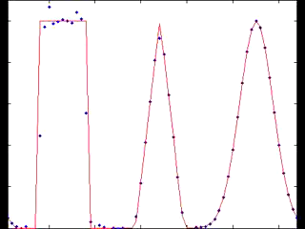
Description of methods reviewed
Streamline Upwind Petrov-Galerkin (SUPG)
Finite Element approach
Inspired by finite difference methods (upwinding and artificial diffusion)
Applies to linear advection/diffusion equations of any dimension
Is neither TVD nor conservative

